Slide 1
RAVES
Blueprint Next Phase
Blueprint
Blueprint Books
Construction financial control
Run job-costed books inside the platform Raves already uses, instead of spreadsheets and disconnected accounting.
Decision ask: approve the Books Foundation build and confirm the accounting owner and opening balances.
Prepared for Raves Inc. / Raves Construction
June 9, 2026
Blueprint Books for Raves
01

Slide 2
WHY NOW
The money already flows through Blueprint. The books do not yet.
Quotes, vendors, and attachments live in Blueprint, but profit, A/R, and A/P still live in spreadsheets.
$9.3M
536
48
23
open value in the loaded quote log
loaded quote-log records
task records driving job activity
email attachments (invoices, bills, POs)
8 / 4
0
27
provisioned users / active last 7 days
of that visible as job-costed books today
prospect records feeding future revenue
Blueprint Books for Raves
02

Slide 3
SYSTEM MAP
Turn work Raves already tracks into double-entry books.
What Blueprint already holds
Blueprint Books ledger
What Raves leadership sees
Won quotes and contract value
Job-costed chart of accounts
Profit per job, not guesses
->
->
Vendor bills and POs
Invoices, payments, A/R aging
Who owes us and what we owe
Customer and vendor records
Bills, payments, A/P aging
Tax-ready P&L and balance sheet
Job activity and attachments
Journal, trial balance, close
Clean, locked month-end
Blueprint Books for Raves
03

Slide 4
THE GAP
RAVES
The financial picture is stitched together by hand.
Blueprint
The risk is not a lack of revenue. It is that revenue, cost, and cash live in separate places, so profit is a guess until the accountant catches up.
Job profit is a guess
A/R slips
Retainage by hand
Month-end is manual
Costs sit in spreadsheets and email, so margin per job is only known late, if at all.
Without aging in the tool, slow-paying customers are noticed by feel, not by report.
Retainage receivable and payable on construction jobs is tracked manually and easy to lose.
Closing the books means re-keying Blueprint data into separate accounting software.
Recommended next funded phase: Blueprint Books Foundation.
Blueprint Books for Raves
04

Slide 5
WHAT IT DELIVERS
A real set of construction books, already built into Blueprint.
Job costing
Invoices & A/R
Bills & A/P
Profit and margin per job, built from invoices, bills, and expenses tagged with the job.
Invoice customers from won quotes, record payments and credit memos, watch A/R aging.
Vendor bills, payments, vendor credits, one-click expense entry, and A/P aging.
Ledger & registers
Statements & reports
Close & PDFs
Double-entry journal, a live trial balance, and a running-balance register per account.
Income statement, balance sheet, cash flow, and P&L by month — print-ready on demand.
Lock a period when it is final, and send branded invoice, bill, and statement PDFs.
Blueprint Books for Raves
05

Slide 6
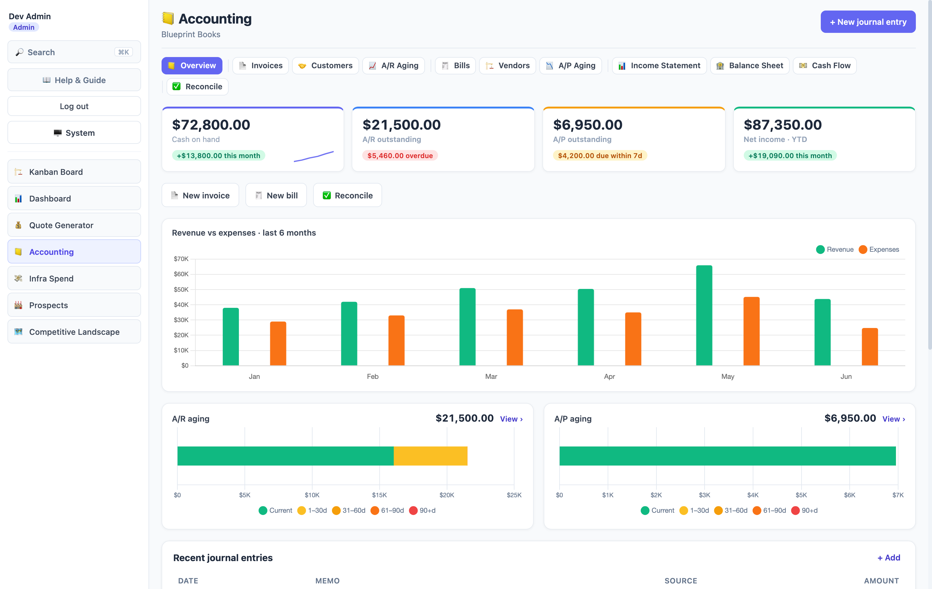
PRODUCT WALKTHROUGH
Already built — this is the live product, not a mockup.
Screenshots from the deployed module with demo books loaded; every figure ties out.
Money at a glance
Cash, A/R, A/P, and profit — each with month-over-month direction.
Trend, not guesswork
Six months of revenue vs expenses, with net income per month.
Urgency built in
Overdue invoices and bills due this week surface themselves.
Blueprint Books for Raves
06

Slide 7
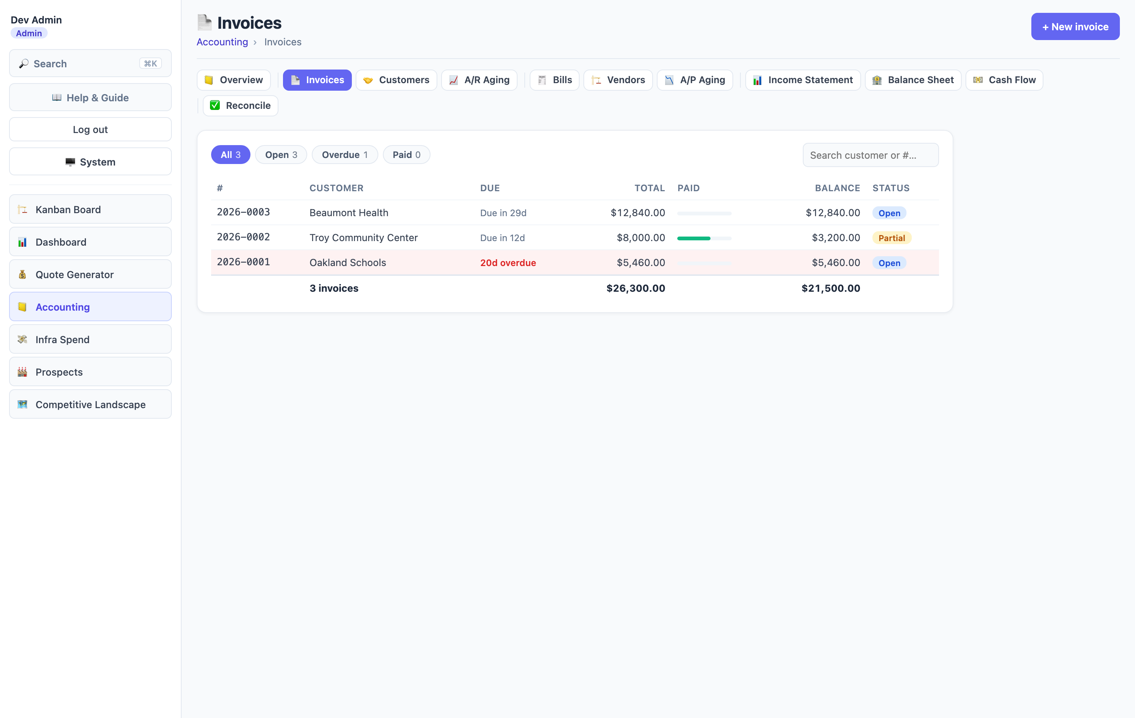
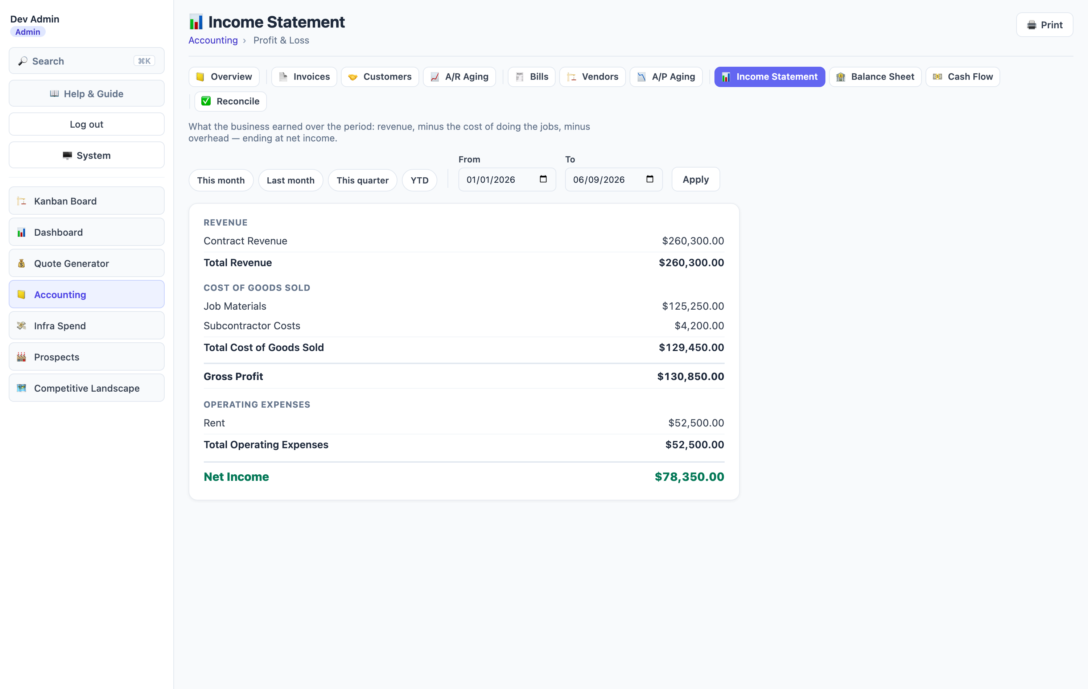
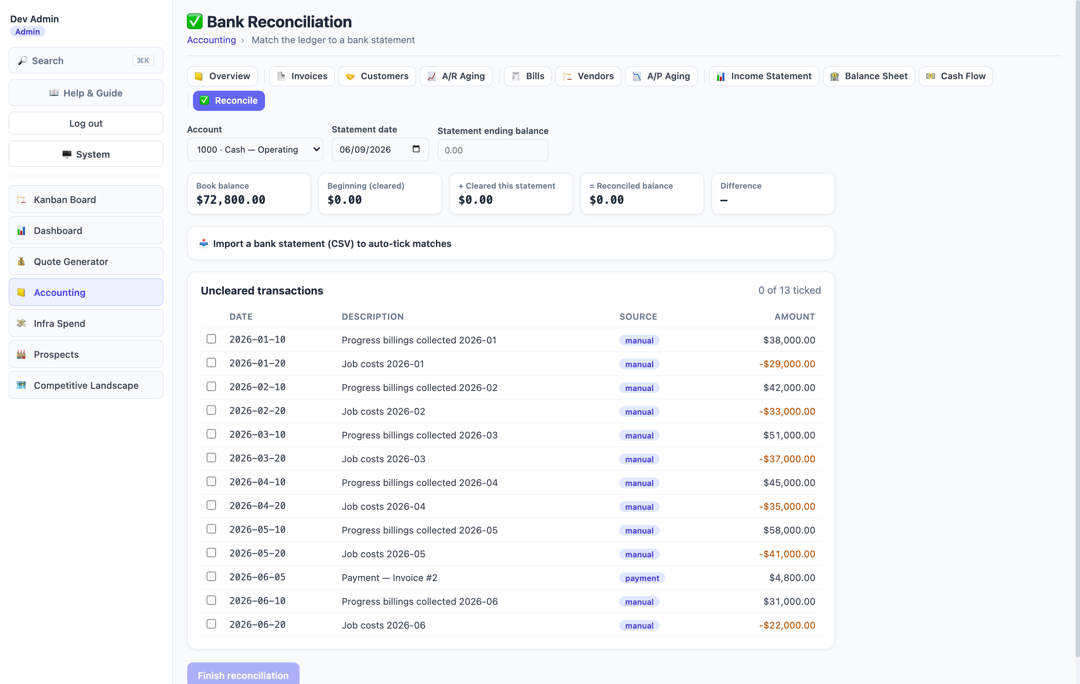
PRODUCT WALKTHROUGH
From invoice to clean statements.
Invoices: status filters, overdue flags, payment progress
Income statement: one-click periods, print for the bank
Bank reconciliation: tick to zero, CSV auto-match
Also in the product
Vendor bills and A/P, customer and vendor directories, A/R + A/P aging, balance sheet, cash flow, account registers, job costing, recurring transactions, credit memos and void, customer statement PDFs, quick expense entry, period close, invoice/bill PDFs, dark mode.
Blueprint Books for Raves
07

Slide 8
ALREADY SHIPPED
The QuickBooks-replacement layer is live in the product.
Everything below is deployed today — rollout work, not a build-from-scratch roadmap.
Account registers
Report pack
Job costing
Running-balance history for every account — a checkbook view per ledger line.
General Ledger, Journal, and P&L by month, alongside the three statements.
Per-job profit and margin from invoices, bills, and expenses tagged with the job.
Credits & void
Customer statements
Recurring & expenses
Credit memos, vendor credits, and void — every correction an append-only reversal.
A PDF of a customer’s open invoices with ages and total due, collections-ready.
Recurring invoices, bills, and journals that never double-post; one-click expenses.
Blueprint Books for Raves
08

Slide 9
COMMERCIAL PATH
One clean foundation build, then an optional close-support lane.
Books Complete
Books Care
Blueprint Books Foundation
$28,000 adds bank reconciliation, cash-flow statement, data migration from current books, and 30-day hypercare.
Optional monthly lane for month-end review, reconciliation checks, and small accounting changes.
$18,500 fixed fee
50% start / 50% closeout
4-5 weeks from opening-balance readiness
Builds on what is shipped
The ledger, A/R, A/P, registers, job costing, statements, recurring, period close, and invoice/bill/statement PDFs are already built. This phase tailors and rolls them out for Raves.
Blueprint Books for Raves
09

Slide 10
MUTUAL ACTION PLAN
A simple path from decision to first clean month-end.
1
2
3
4
5
->
->
->
->
Select package
Approve SOW
Confirm inputs
Implement
First close
Confirm Books Foundation or the expanded Books Complete scope.
Name the approval owner and target decision date.
Accounting owner, opening balances, chart-of-accounts review, and tax/entity basics.
Tailor the books, load opening balances, wire A/R and A/P, and train the team.
Run the first month-end in Blueprint and lock the period.
Blueprint Books for Raves
10

Slide 11
DECISION
RAVES
Approve Blueprint Books as the next funded phase.
Blueprint
Leave with one owner, one date, and the opening-balance source.
Ask
Approve the Books Foundation build at $18,500 fixed fee.
Then confirm the approver, target decision date, the accounting owner, and where opening balances and the chart of accounts come from.
Next artifact
Next meeting
Next offer
One-page Books SOW and opening-balance checklist.
Kickoff once opening balances are confirmed.
Books Care after go-live for monthly close support.
Blueprint Books for Raves
11

